Slide 1
NUMBER PLATE RECOGNITION
Uvan Sankar. K

Slide 2
ABSTRACT
The project titled Number Plate Recognition is a software for detecting a number plate from an image, recognizes the characters in the image and saves the characters in a csv file.
The project “Number Plate Recognition” is developed using Python and TensorFlow Machine Learning Library.
The project uses TensorFlow’s object detection api to detect the number plate from an image, segment the characters, predict the characters in the number plate using a machine learning model and save the numbers in the number plate in a csv file with date and time.

Slide 3
DEEP LEARNING
Deep learning is a machine learning technique that teaches computers to do what comes naturally to humans: learn by example.
Deep learning is a key technology behind driverless cars, real time text translation, face recognition.
Deep learning models can achieve state-of-the-art accuracy, sometimes exceeding human-level performance.
Inspired by the nerve cells (neurons) that make up the human brain, neural networks comprise layers (neurons) that are connected in adjacent layers to each other.

Slide 4
INTRODUCTION
The registration number is a numeric or an alphanumeric code that uniquely identifies the vehicle within the issuing region’s database.
Number Plate Recognition is a system that uses Machine Learning, Computer Vision and Optical Character Recognition to identify vehicle’s number plates.
The number plate of the vehicle is detected using Machine Learning and Computer Vision.
The vehicle plate’s number is then identified using Optical Character Recognition and saved in the database.

Slide 5
PROBLEM DESCRIPTION
The Automatic Number Plate Recognition is a system designed to help in recognition of number plates of vehicles.
This system helps in the functions like detection of the number plates of the vehicles, processing them and using processed data for further processing like storing, allowing vehicles to pass or to reject vehicle.
Can be used in Parking Systems, Electronic Toll Collection Systems.

Slide 6
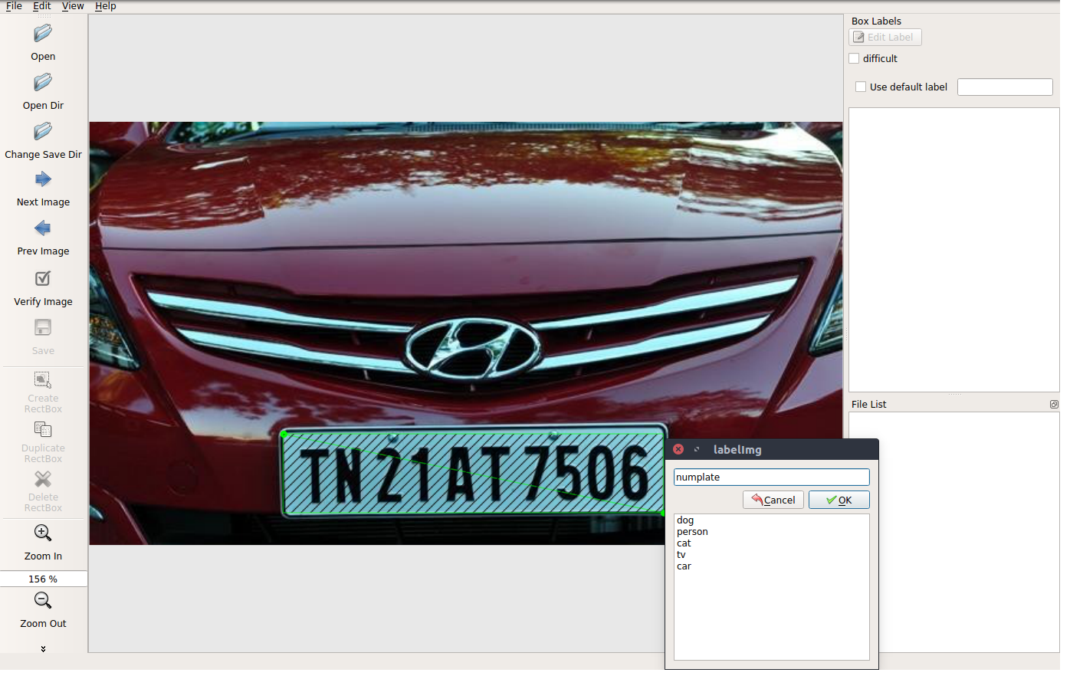
PHASES
Data Collection & Image Labelling :

Slide 7
PHASES
Training:
The Model is trained with the labelled images as the data using Transfer Learning.
Training is done in a virtual environment for TensorFlow GPU.
The Training requires a GPU to train the model and the training phase can take up to 2 hours or more depending upon the CPU and GPU configurations.

Slide 8
PHASES
Testing:
In the testing phase, the trained model is loaded and the prediction starts.
The number plate is detected first and then using OCR, the characters are recognized and then saved in Excel.

Slide 9
HARDWARE SPECIFICATIONS
S.NO | CONTENTS | REQUIREMENTS
1. | PROCESSOR | Intel i5 or i7
2. | RAM | 4GB or Higher
3. | GPU | Nvidia GeForce GTX 940MX or Higher
4. | HARD DISK CAPACITY | 300GB

Slide 10
SOFTWARE SPECIFICATIONS
S.NO | CONTENTS | REQUIREMENTS
1. | OPERATING SYSTEM | Windows 10
2. | FRONT-END | Python 3.6
3. | BACK –END | Microsoft Excel
4. | TENSORFLOW | VERSION 1.13 or Higher

Slide 11
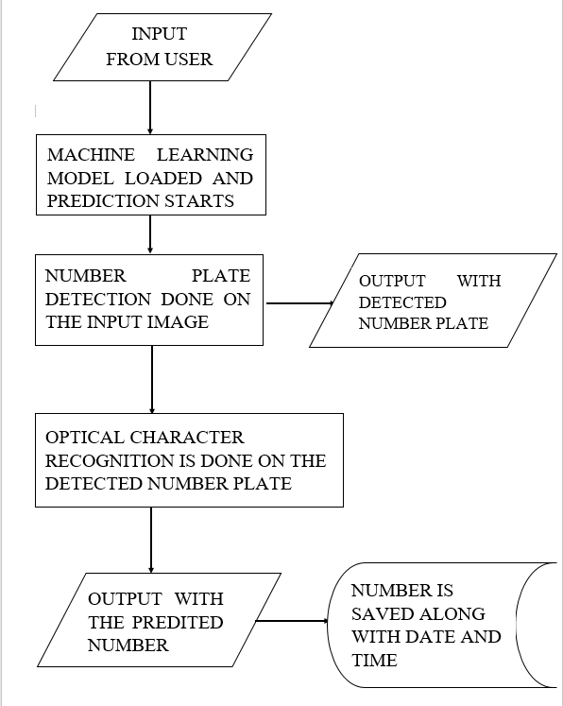
SYSTEM FLOW DIAGRAM

Slide 12
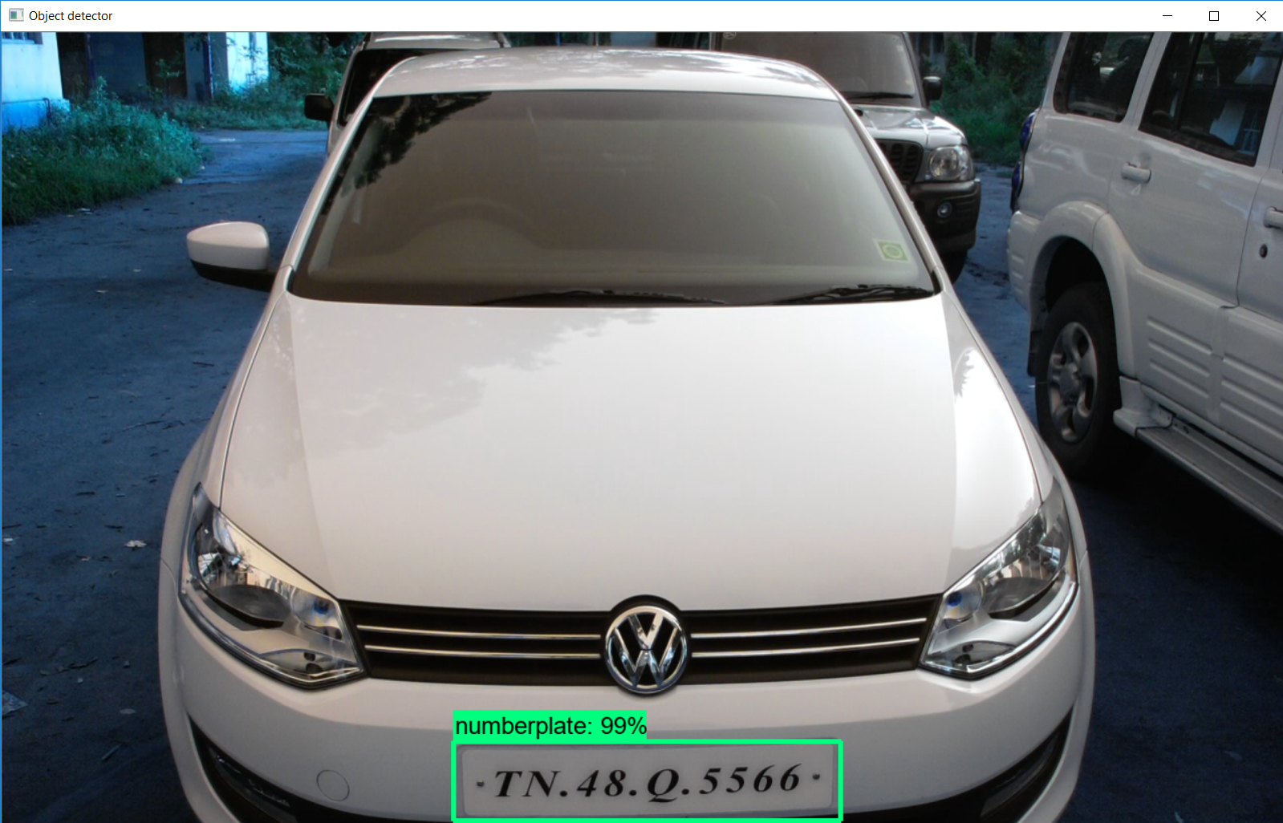
OUTPUT

Slide 13
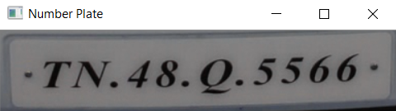
OUTPUT

Slide 14
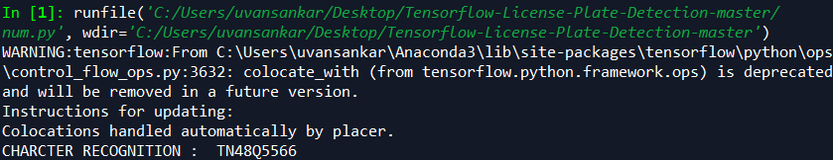
OUTPUT

Slide 15
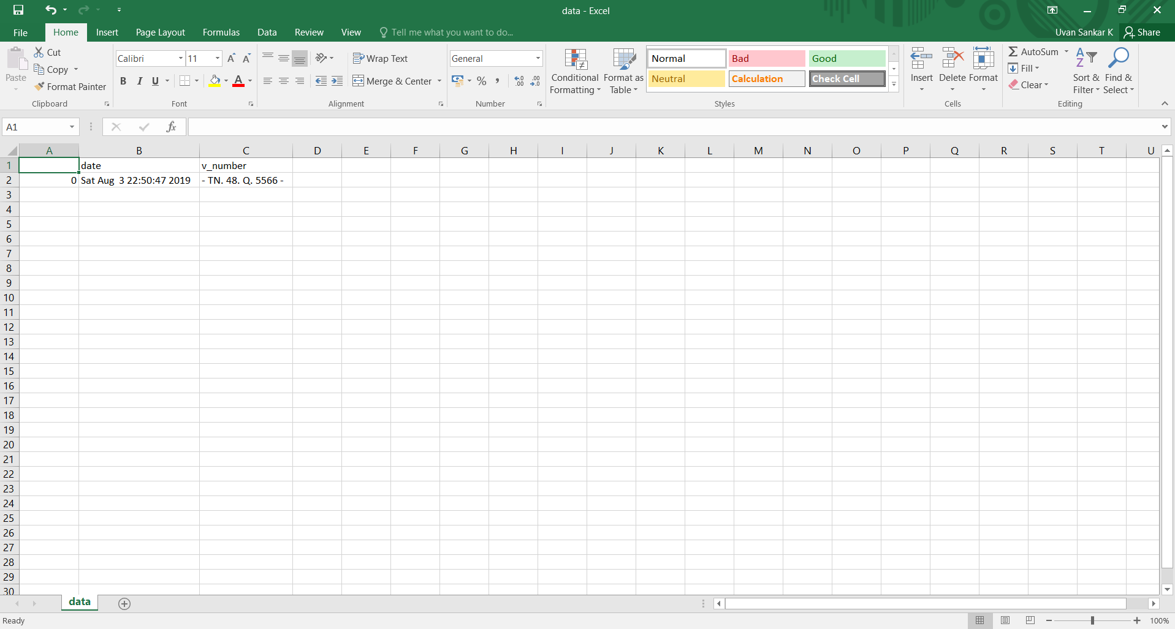
DATA SAVED

Slide 16
THANK YOU!

